Slide 1
On-premise Cloud Deployment of ASR System
Jonathan Yap
Notes:
Good afternoon Profs, today I am going to be presenting the work I have done on my Final Year Project. The focus of which would be the On-premise Cloud Deployment of ASR System. My project seeks to have a scalable yet maintainable deployment of the ASR system onto NTU’s school servers.

Slide 2
Table of contents
01
02
Overview of software
My Contributions
How various software used would fit into the project
Design, implement and solve errors for on-premise deployment
03
04
Future Works
Demo
Potential areas for further development
Demo main features of project
Notes:
These are the table of contents for today.
First, I would go through the overview of the various software used and how they would fit into the project.
Next, I would be going through my contributions to the project.
Then, I will touch a bit on the future works of the project.
And finally, I would have prepared a demo video on the working product of my project.

Slide 3
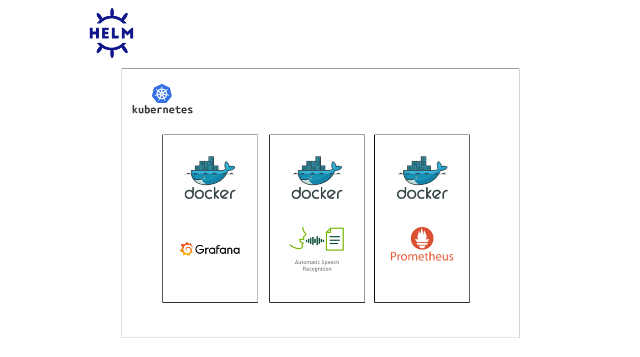
Overview
Notes:
Starting off with the overview of the different technologies and where they fit into the whole project. These technologies would help with the deployment lifecycle and would be used to deploy different softwares onto an on-premise school server.
We have Helm for packaging, Kubernetes for container orchestration, Docker for the container runtime, the ASR system which is the main program to be deployed onto the school’s servers, Grafana for metrics visualisation and Prometheus for metrics monitoring.
The ASR system, Grafana and Prometheus would be hosted in a Dockerised environment, managed by Kubernetes. Helm would help package the deployment to allow easy set up and allow versioning of each Helm deployment package.

Slide 4
Automatic Speech Recognition (ASR)
Notes:
Now, I would like to start with the introduction to the main program to be deployed onto the school’s servers. This program is the Automatic Speech Recognition system, or the ASR system for short.

Slide 5
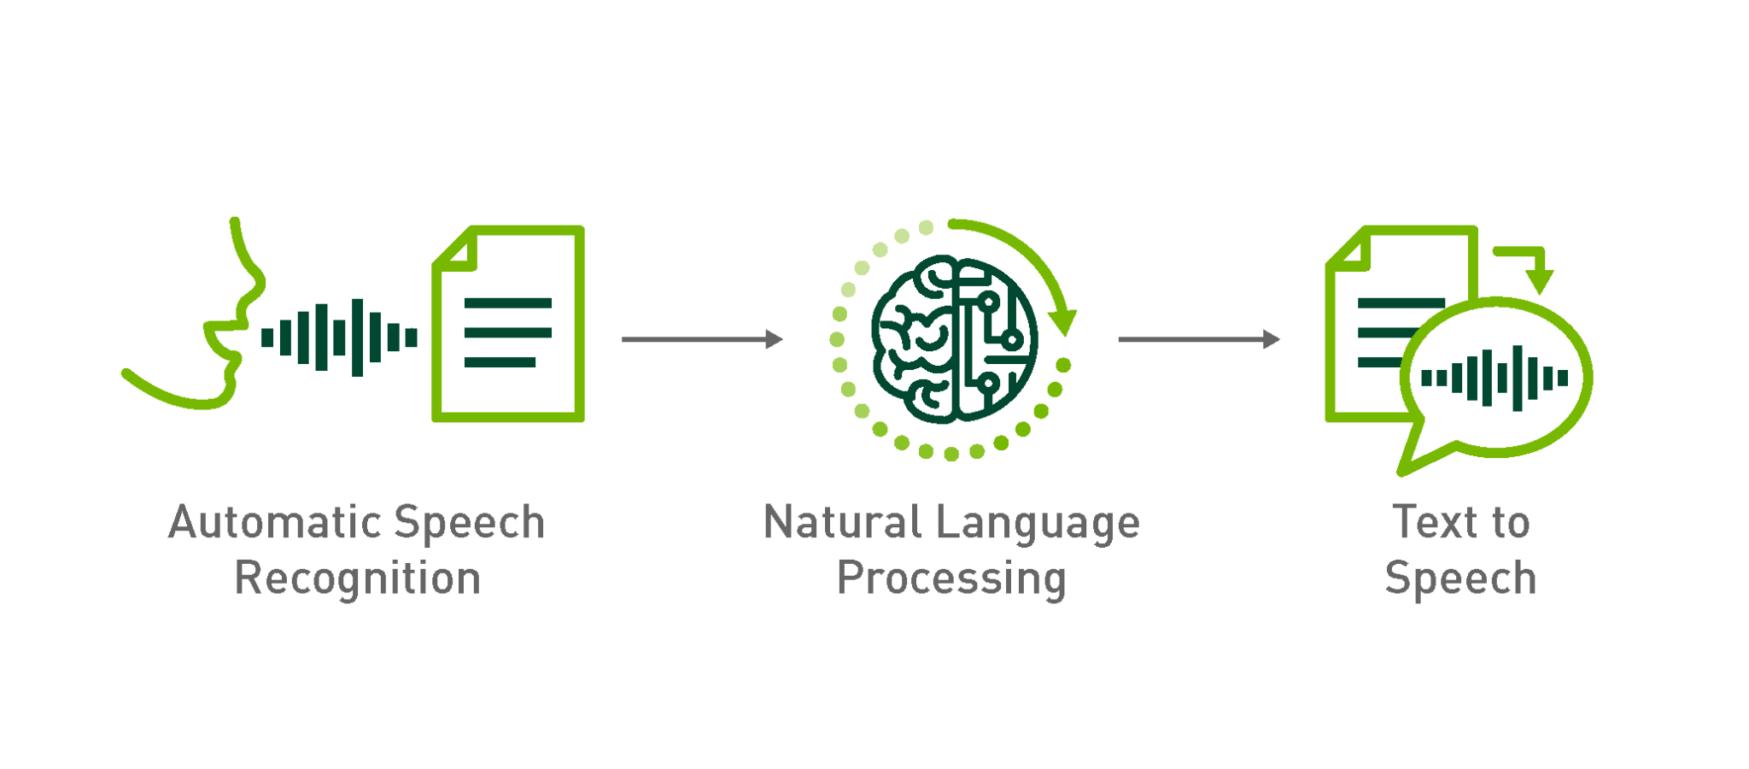
Automatic Speech Recognition (ASR)
Based on Kaldi
Open source speech recognition toolkit
Speech to text
Able to transcribe a mixture of languages
Notes:
The Automatic Speech Recognition (ASR) system is developed by AISG Speech Lab.
The ASR system is developed based on the open source speech recognition toolkit, Kaldi. Its basic functionality is to transcribe speech to text.

Slide 6



Problem Statement
What about on-premise deployment?
Deployment work exists cloud provider platforms
Need for on-premise deployment?
On-premise deployment does provide benefits
Notes:
This would bring us to the problem statement of my project. In previous FYPs done by seniors, deployment work for most of the more popular cloud providers are already out there. On-premise deployment for the ASR system has not been done before.
There is also a potential need for on-premise deployment as there are some benefits of on-premise deployment over deployments on cloud providers.

Slide 7
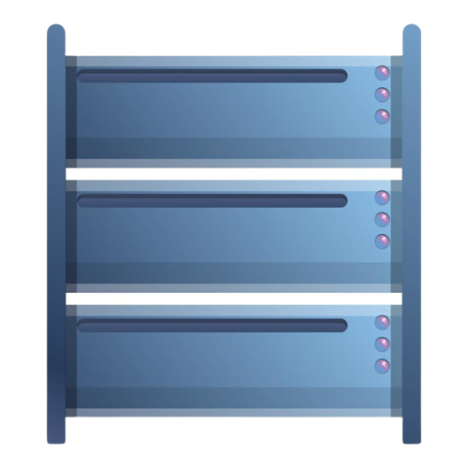
Why on-prem?
1
More control over resources
Sensitive data can be kept within organisation
2
3
Operate without the internet
Notes:
Some of the motivations for on-premise deployments is to allow the developer more control over the resources as many of the configurations have to be implemented by the developers. This would allow more flexibility and customisability as compared to deployments over traditional cloud providers.
Some reasons for this customisability and to use on-premise deployments could be due to security concerns. For example, for sensitive data, it would make more sense for them to be stored on servers that are not belonging to another organisation.
On-premise deployments also allow for the option for the application to operate without the internet, in a private network. This would be a security feature as the internet is inherently risky and prone to all kinds of cyber attacks.

Slide 8
Docker
Notes:
Next, I will be moving on to Docker. Docker is located above the applications. Docker is used to host the various software programs like the ASR program mentioned earlier.

Slide 9
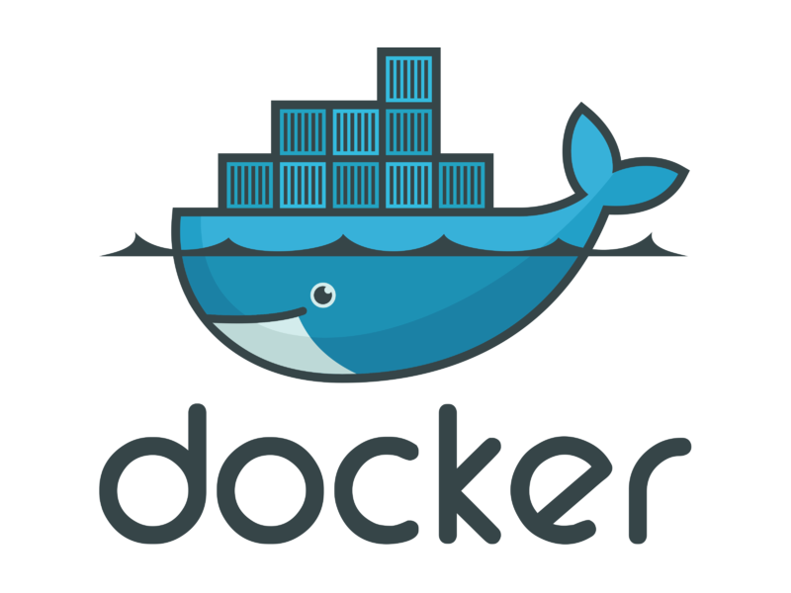
Docker
Containerisation Technology
Lightweight virtualisation of application environment
Alternatives
Podman, Buildah, CRI-O
Benefits
More community support and resources
Notes:
Docker is currently the most popular containerisation tools out in the market.
Docker makes use of containerisation technology, which is a type of virtualisation technology, to provide similar benefits to virtual machines. This means that it can simulation the environment needed for applications to run virtually on top of the host operating system.
The alternatives to Docker include: Podman, Buildah and CRI-O.
The main reason for choosing Docker in this project is the wide range of community support and resources available online.

Slide 10
Kubernetes
Notes:
Kubernetes, located above Docker in the tech stack, would actually help to manage the containers that Docker creates to host the applications.

Slide 11
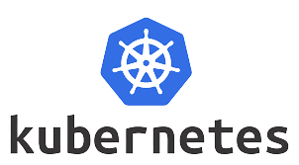
Kubernetes
Container Orchestration
Automation of the operational effort required to run containerised applications
Alternatives
Docker Swarm, Nomad, Mesos
Benefits
More community support and resources, backed by Google
Notes:
The most popular container orchestration software now is Kubernetes.
Kubernetes is a container orchestration tool that automates the deployment, scaling, and management of containerized applications. It provides a consistent and efficient framework for deploying and managing applications in a variety of environments, improving scalability and availability.
Kubernetes is used in this project as a platform to deploy the ASR system to and to manage the deployment in a relatively simple manner.
Some other the alternatives to Kubernetes is Docker Swarm, Nomad and Mesos.
Reasons why I have chosen Kubernetes over its alternatives is that it has more resources and community support, it is also backed by Google, and it has by far the most features available.

Slide 12
Grafana
Notes:
Moving on to the other software being deployed alongside the ASR system, we have Grafana. Grafana is also deployed in a Docker container which would be managed by Kubernetes.

Slide 13

Grafana
Visualising Metrics
Web interface to create and share interactive dashboards
Alternatives
Kibana, Zabbix
Benefits
More community support and resources, user-friendly interface, easy to set up and use
Notes:
Grafana is a popular open-source platform for data visualisation and analytics. It provides a powerful and intuitive web interface that allows users to create and share interactive dashboards, charts, and graphs, based on data from various sources, including Prometheus.
Some alternatives to Grafana include: Kibana and Zabbix
The main reason for choosing Grafana is that it has more community support, more resources available and a user friendly and intuitive interface which is easy to set up and use.

Slide 14
Prometheus
Notes:
Next, we have the last software being deployed into the system, Prometheus. Promethus, like the ASR system and Grafana is also deployed in a Docker container which would be managed by Kubernetes.

Slide 15

Prometheus
Event monitoring & alerting
Monitoring system that is designed to collect and store time-series data
Alternatives
InfluxDB, Nagios
Benefits
More community support and resources, wide range of use cases, works well with Kubernetes and Grafana
Notes:
Prometheus is an open-source monitoring system that collects and stores time-series data from various sources, including Kubernetes clusters. It serves as a data source for Grafana to display metrics in a visual dashboard, enabling administrators to gain insights into application and infrastructure performance and quickly identify and resolve issues.
Some alternatives to Prometheus include: InfluxDB and Nagios
The reasons why I chose Prometheus over its counterparts is that it has more community support and resources, has a wider range of use cases and it integrates well with Kubernetes and Grafana.
Together, Prometheus and Grafana provide a powerful monitoring and visualization platform for modern applications and infrastructure and is very commonly used together in a Kubernetes environment.

Slide 16
Helm
Notes:
The last item on the techstack is Helm which would package the Kubernetes deployment to be able to be deployed easily.

Slide 17

Helm
Package Manager
Package the Kubernetes deployments for better workflow
Alternatives
Kustomize, Jsonnet, Skaffold
Benefits
More community support and resources, more features
Notes:
Helm is an open-source package manager for Kubernetes that simplifies the deployment and management of complex applications with charts. Charts are a single, reusable unit that package applications and their dependencies, making it easy to deploy and manage complex applications in a consistent, repeatable manner.
Alternatives include: Kustomize, Jsonnet, Skaffold
Reasons why I chose Helm is that it has more community support and resources as well as more features.

Slide 18
Overview
Notes:
Put all the software together and we would get the see how each of the software helps with creating a robust deployment for the ASR system which would allow further development. Docker is used to create container environments for the various softwares to run in, Kubernetes would be used to manage the containers and Helm would be used to package the Kubernetes deployment.

Slide 19
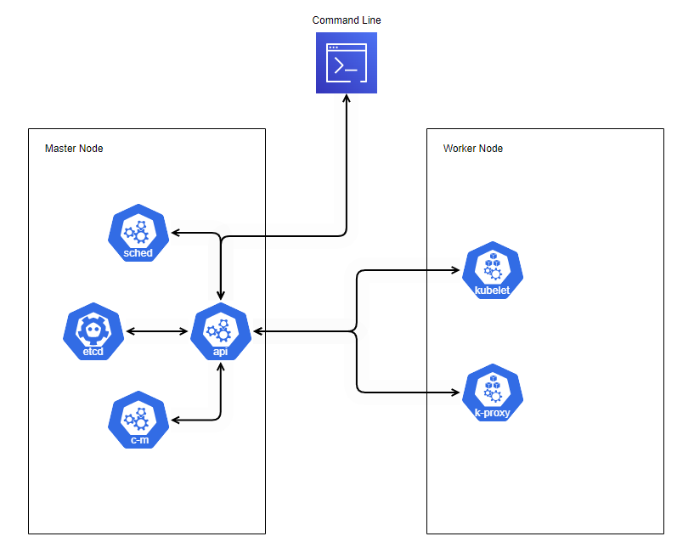
Structure of Kubernetes Cluster
Notes:
Now, we have come to what I have contributed in this project. I would be sharing a high level architecture of the deployment I have as well as the steps I took to implement my design.
The structure of the cluster consists of 2 nodes, a master and a worker node. There is also room for more worker nodes to be in the cluster to cater for more traffic surges in case there is more demand for the use of the ASR system. The master node has a control plane and is where the cluster administrator would send all the commands to and it would manage the worker node using the control plane.
The control plane consists of a few components, apiserver, etcd, scheduler and control-manager. The apiserver exposes the K8s API and is the entry point for the commands to be sent into by the cluster administrator. Etcd is used to store the metadata of the cluster. Scheduler assigns the pods, which is the smallest deployable unit in Kubernetes, containing the actual programs to be deployed. Think of a pod running a container which contains the applications. The control manager runs the control processes.
The worker node would be where the actual applications are deployed onto. It contains a kubelet and kube-proxy. Kubelet is to ensure healthy container runtime in each Pod meaning it would ensure that the applications are always in the desired state. Kube-proxy runs on each node in the cluster and maintains network rules, enabling both internal and external communication with the Pods.

Slide 20
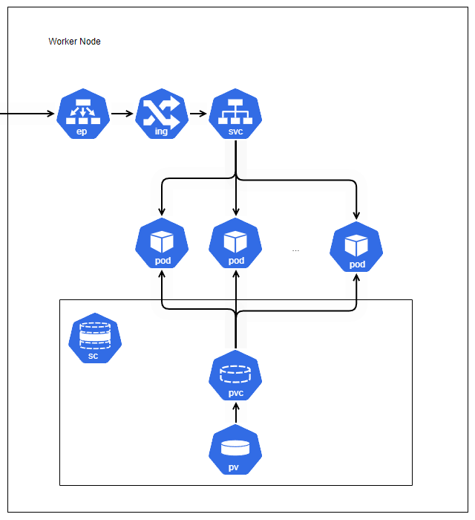
Deployment Architecture
Notes:
To comprehend the intended deployment, it is essential to have an understanding of the components that constitute the ASR system. The ASR system is composed of two primary parts - a server process and a worker process. The ASR server process receives and manages the client requests while the ASR worker process carries out the actual transcription process. These processes are to be deployed in Docker containers that runs on a pod in the Kubernetes cluster.
Furthermore, it is necessary to have a volume mount to enable the worker process to access the transcription models. These transcription models would need to be located in a persistent volume so that they would always be available for access.
We would also need traffic routing components to route the requests for the ASR system to the correct pods.
Next, the monitoring and visualisation tools, Grafana and Prometheus would be deployed in the cluster in order to be able to have a visual on the state of the cluster at any given point.
Finally, everything would be packaged up using Helm packaging.

Slide 21
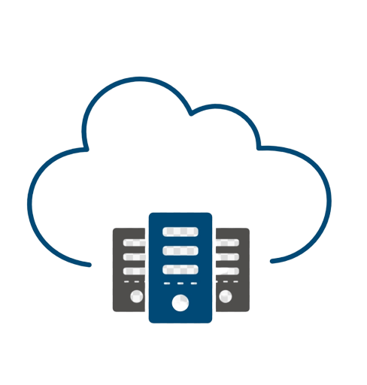
Implementation
Docker deployment
On-premise deployment
Cloud platform deployment
Notes:
The actual process of implementing the on-premise cloud deployment of the ASR system comprises of several stages. These are, Docker Deployment, Deploying on cloud providers and On-Premise Deployment.
The first stage of getting to understand the deployment is to be able to set up a Dockerised version of the application. This would allow a better understanding of what components are required for the deployment of the ASR system.
Next, would be the deployment of the ASR system on cloud providers like AWS and Azure. This would allow me to test out the actual deployment of the ASR system on a Kubernetes system while still being able to use the in built features in the cloud providers like the load balancer making it easier on the deployment.
Finally, the actual deployment of the ASR system on NTU servers. This would be similar to the deployment on cloud providers but with additional steps taken. For instance the implementation of load balancers and networking between nodes.
After the main part of the project is complete, I moved on to deploy and set up Grafana and Prometheus to be able to monitor the metrics of the cluster and allow the cluster admin to be able to easily understand the state of the cluster at any point in time.
Helm packaging for the deployment is then created in order to easily track the versioning and keep the system maintainable.

Slide 22
Infrastructure Setup
First
Provision
Next
Install
Control Plane
Provisioning physical/virtual machines
Installing the necessary software
Setting up the control plane
Network
Application
Monitoring
Setting up the networking
Deploying the application
Deploying monitoring tools
Notes:
We would be focusing more on the implementation of the on-premise deployment. These are the steps for the deployment to work properly.
Firstly, we would have to provision the physical servers to act as our nodes.
Next, we would have to install the necessary software onto the provisioned servers, including Kubernetes and Docker.
We would have to set up the control plane on the master node of the cluster and create the cluster.
Before the worker node can join the cluster, networking between the master and worker nodes has to be set up. This is to allow the nodes to be able to communicate with each other.
After the worker node joins the cluster, we can start deploying the applications. This would require the deployment of the traffic routing components to allow external requests to reach the application, as well as storage components to allow the ASR system to access the language models. Afterwhich, the actual ASR system can then be deployed.
Finally, the monitoring tools can be deployed.
Next, we would be focusing on the main part of the implementation of my project, which are setting up parts of the infrastructure which are more unique to the on-premise deployment. These are namely, Control plane set up, Network set up, application and monitoring tools deployment.

Slide 23
Setting up Control Plane
Notes:
Setting up a Kubernetes control plane on the master node. To set up the control plane, install the Kubernetes control plane components on the master node(s), including the API server, etcd, kube-scheduler, and kube-controller-manager. This can typically be done using a package manager or by downloading and installing the binaries manually. Configure each of the components based on the available resources from the server machines.

Slide 24
Setting up the networking
Notes:
Networking between nodes has to be set up for on-premise deployment. This is because for deployment on cloud providers such as AWS, the cloud providers would have taken care of the networking such that each node would be able to communicate with the others as long as they are in the same private network.
Configure the kernel to support the required networking capabilities for a Kubernetes cluster. This would setup the required system parameters on the actual servers themselves for the networking to work properly for the servers to be able to communicate with each other. These parameters include enabling IP forwarding, setting up network bridge call parameters, and loading kernel modules.
Afterwhich, I would have to set up a networking solution for Kubernetes that provides a simple and reliable way to manage the networking requirements of containerised applications.
For this, I have decided to for for Flannel to create a virtual network to allow containers to communicate with each other and the external network. Flannel uses an overlay network to abstract the physical network and provide network isolation between different container workloads.

Slide 25
Setting up traffic routing
Notes:
Traffic routing components I need to set up are the ingress, service and load balancer. The ingress is used to do the actual routing of traffic to the pods containing the required software. The service is used to tie up the internal addresses of the pods this is to provide abstraction between external traffic from the pods as well as between pods to allow for more flexible and scalable deployment of applications. The load balancer would create a public endpoint also known as an external IP address.
The difficulty of deploying the ASR system on-premise is that there is no load balancer service being provided by traditional cloud providers like AWS, GCP or Azure. MetalLB is a popular choice for an on-premise load balancer and it is used in this project.

Slide 26
Setting up storage providers
Notes:
Before deploying the applications, the persistent storages must be set up first to ensure the availability of the language models for the ASR system to be able to access. To be able to set up persistent storage, a storage class must first be set up so that the persistent volume could implement it. Then a persistent volume claim must be set up so that the pods would be able to use it to request access to the persistent volume from the cluster. This persistent volume claim allows for abstraction between the pods and the underlying storage, enabling a more flexible and scalable deployment of applications. Finally, the storage can be set up.

Slide 27
Deploying the application
Notes:
Finally, deploying the ASR program together with the monitoring and visualisation tools, Grafana and Prometheus into containers which would run on the pods.

Slide 28
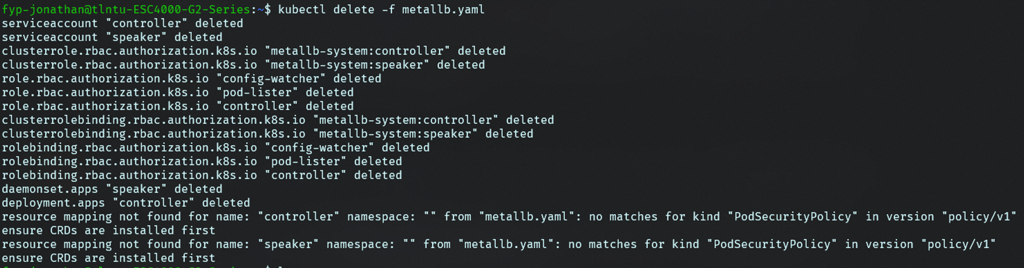
Some Problems Faced
Notes:
There were many issues faced implementation of the project. Some of the more notable ones include, PodSecurityPolicy deprecation and crashing of worker’s kube-flannel and kube-proxy pod.
For the PodSecurityPolicy deprecation, it was deprecated in Kubernetes version 1.25, so it was necessary reverting it back to version 1.24.

Slide 29
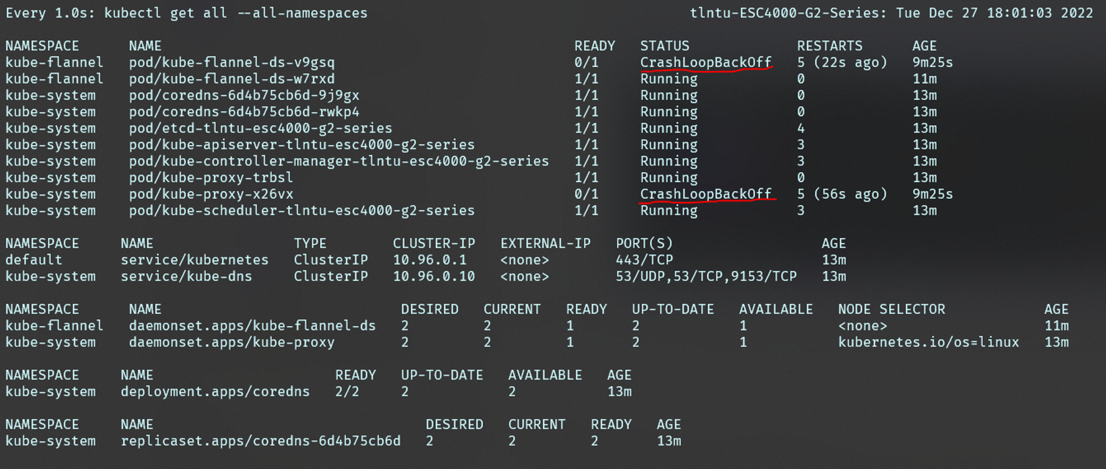
Some Problems Faced
Notes:
For the crashing of worker’s kube-flannel and kube-proxy pod, after some research, it was revealed that the issue was caused by a configuration problem in the Nvidia GPU’s configuration. The Nvidia K8s plugin had differing documentation on Nvidia.com [49] compared to that on GitHub [50], making it challenging to diagnose and resolve the issue as it was beyond the scope of the project. Nonetheless, after some testing and debugging, a solution that proved effective being the inclusion of ”SystemdCgroup = true” in /etc/containerd/config.toml.

Slide 30
Future Works
01
Continuous Delivery
easier to add new components into the cluster
02
Automated Provisioning Tools
reduce the manual effort required for setting up new nodes
03
Security
access controls, securing network channels
Notes:
Now let’s move on to what the project did not manage to cover and take a look at some of the future works that could be expanded upon in this project.
One area of the project that could be expanded on is to include Continuous Delivery into the solution, making it easier to add new components into the cluster. This could involve automating the deployment process, enabling automatic testing and integration of new code, and providing feedback loops for developers.
Another potential area of development could be the inclusion of automated provisioning tools such as using tools like Terraform or Ansible. This would help to reduce the manual effort required for setting up new nodes, and would also provide a more repeatable and consistent approach to infrastructure management.
Finally, it may be worth considering ways to enhance the security of the cluster, since security is not currently a major part of the project. This could involve implementing authentication and access controls, securing network communication channels, and regularly updating and patching the underlying software components.

Slide 31
Conclusion
On-premise | Needed in some situations
 | Harder to implement
Setup and Deploy | Deployed on cloud providers
 | Deploy on NTU servers
Package | Package deployment in Helm
 | Allows for better workflow
Notes:
On-premise deployments have some benefits, mostly due to security reasons. It also requires more consideration and efforts to implement.
In the course of the project, a Docker and K8s solution was conceptualised and realised on AWS and EC2 as well as the actual NTU servers. The ASR
system which was deployed was functioning as expected, and there is room for scaling according to traffic workload.
Monitoring tools like Prometheus and Grafana was also deployed on the same cluster giving the cluster administrator a more visual cue on the state of
the cluster.
Helm Charts are used in the project to improve the workflow by providing packaging and versioning. This allows better scalability if there are additional components which are needed in the K8s cluster in the future.
Now, let’s move onto the demo video!

Slide 32

Demo

